Slide 1
CSC 309: Artificial Intelligence
Ali Ahmad Aminu, PhD
Computer Science Department, Gombe State University
2025/2026 Session

Slide 2
Week 2: Search

Slide 3
Week 2: Outline
Search
Problem Solving by Search
Search Strategies
Uniformed Search
Informed Search

Slide 4
Week 2: Introduction to Search
What is Search?
Search is a class of techniques for systematically finding or constructing solutions to problems.
Search is a fundamental technique in AI used to explore possible solutions to a problem by systematically examining different states (solutions)
In AI, search algorithms are used when:
The solution is not known in advance but can be discovered by navigating through different states or configurations
The problem can be broken down into states and transitions.
The goal is to find an optimal or feasible sequence of actions leading from an initial state to a desired goal state.

Slide 5
Week 2: Why is search important in AI?
Many real-world and AI problems can be modeled as search problems, including:
Problem Type | Example Applications
Path Planning | Robot navigation, GPS route optimization
Puzzles | 8-Puzzle, Sudoku, Rubik’s Cube
Games | Chess, Tic-Tac-Toe, Poker (adversarial search)
Scheduling | Job-shop scheduling, airline crew assignments
Optimization | Traveling Salesman Problem (TSP), resource allocation

Slide 6
Week 2: Problem Solving by Search
A search problem is defined by five key components:
Initial State (s₀)
The starting point of the search (e.g., a scrambled 8-puzzle).
Actions (Actions(a))
The set of possible moves from a given state (e.g., moving the blank tile in the 8-puzzle).
Transition Model (Result(s, a))
Describes the state resulting from taking action *a* in state *s*.
Defines the state space (all reachable states from s₀ via actions).
Goal Test (Goal(s))
Determines whether a given state is a solution (e.g., tiles in correct order for the 8-puzzle).
Path Cost (c(s, a, s’))
Assigns a cost to each action (often used in optimization, e.g., number of moves in the 8-puzzle).

Slide 7
Week 2: Problem Solving by Search
State Space representation
The state space forms a graph: (V, E) where:
V is a set of nodes (states) E is a set of edges (actions) Each edge is directed from one node to another node
Nodes corresponds to States
Edges corresponds to applicable Actions
A path in the state space is a sequence of states connected by a sequence of actions.
A solution is a path from the initial state to a goal state.

Slide 8
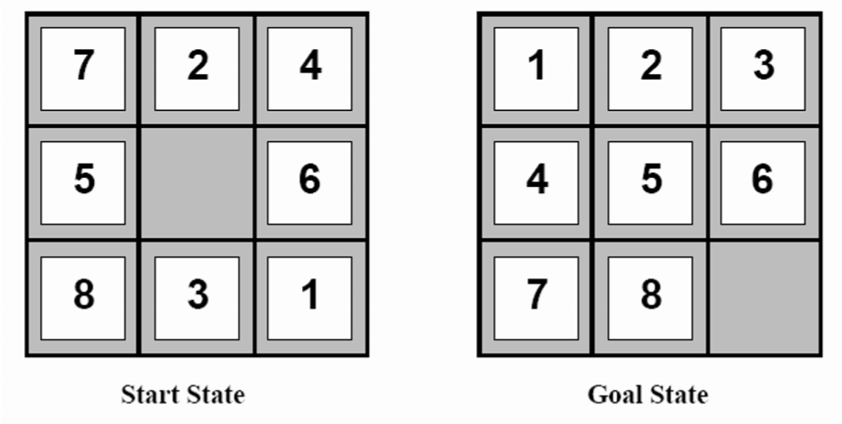
Week 2: Problem Solving by Search - Example
Initial state
A random arrangement of the titles e.g. state shown on left of figure 1
Actions/Operations
Moving the blank up, down, left, right. Can every action be performed in every state?
Transition Model
New state after moving the blank (e.g., moving _ up swaps it with the tile above).
Goal Test
be in a state where the tiles are all in the positions shown on the right of figure 1
Path Cost: Number of moves taken, optimal solution minimizes total moves
The 8-Puzzle
Problem Statement: Rearrange tiles from a scrambled initial state to a goal state.
Figure 1: 8 Puzzle initial and goal state
Rule: can slide a tile into the blank spot or move the blank spot around

Slide 9
Week 2: Problem Solving by Search - Example
The Missionaries and Cannibals Problem
Problem Statement: 3 missionaries and 3 cannibals must cross a river using a boat that holds up to 2 people. If cannibals ever outnumber missionaries on either shore, the missionaries are eaten.
Component | Description
Initial State | (Left: 3M, 3C, Boat; Right: 0M, 0C)
Actions | Boat crossings with 1-2 people (e.g., "Move 1M + 1C to right").
Transition Model | Update counts on both shores after each valid move.
Goal Test | (Left: 0M, 0C; Right: 3M, 3C, Boat)
Path Cost | Each crossing = 1 (minimize total trips).

Slide 10
Week 2: Problem Solving by Search
Search Process
Exploration: The agent generates a search tree (all possible action sequences).
Evaluation: Selects paths likely to lead to the goal (using strategies like BFS, DFS, A*).
Termination: Stops when a goal state is reached or all possibilities are exhausted.

Slide 11
Week 1: Evaluating Search Strategies
Completeness: Will the search always find a solution if a solution exists?
Time Complexity: How long does it take to find a solution? Usually measured in terms of the number of nodes expanded
Space Complexity: How much space is used by the algorithm? Usually measured in terms of the maximum number of nodes that can be stored
Optimality: Will the search always find the least cost solution? (when actions have cost)

Slide 12
Week 2: Search Strategies/Algorithms
Uninformed Search (aka Blind Search)
Adopt a fixed rule for selecting the next state/node to be expanded
Uses no information about the problem domain to guide the search
Uninformed Search Algorithms
Breadth First Search (BFS)
Depth First Search (DFS)

Slide 13
Week 2: Breadth First Search Algorithm
Algorithm outline
Always choose the node from the list (OPEN) that is at the smallest depth (closest to the starting point) and expand it.
Add any newly created nodes to the list (OPEN).
The list (OPEN) works like a queue, following a "first in, first out" (FIFO) order.
Terminate when the chosen node for expansion is the goal.

Slide 14
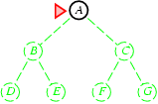
Week 2: Breadth-first search
Expand shallowest unexpanded node
List/Open (or fringe): nodes in queue to be explored
List is a first-in-first-out (FIFO) queue, i.e., new successors go to end of the queue.
Goal-Test when inserted.
Future= green dotted circles
Frontier=white nodes
Expanded/active=gray nodes
Forgotten/reclaimed= black nodes
Initial state = A
Is A a goal state?
Put A at end of queue.
frontier = [A]

Slide 15
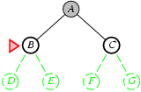
Week 2: Breadth-first search
Expand shallowest unexpanded node
List/Frontier is a FIFO queue, i.e., new successors go at end
Expand A to B, C.
Is B or C a goal state?
Put B, C at end of queue.
frontier = [B,C]

Slide 16
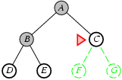
Week 2: Breadth-first search
Expand shallowest unexpanded node
Frontier is a FIFO queue, i.e., new successors go at end
Expand B to D, E
Is D or E a goal state?
Put D, E at end of queue
frontier=[C,D,E]

Slide 17
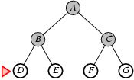
Week 2: Breadth-first search
Expand shallowest unexpanded node
Frontier is a FIFO queue, i.e., new successors go at end
Expand C to F, G.
Is F or G a goal state?
Put F, G at end of queue.
frontier = [D,E,F,G]

Slide 18
Week 2: Breadth-first search
Expand shallowest unexpanded node
Frontier is a FIFO queue, i.e., new successors go at end
Expand D to no children.
Forget D.
frontier = [E,F,G]

Slide 19
Week 2: Breadth-first search
Expand shallowest unexpanded node
Frontier is a FIFO queue, i.e., new successors go at end
Expand E to no children.
Forget B,E.
frontier = [F,G]

Slide 20
Week 2:Breadth First Search Algorithm
Properties of BFS
Complete
Will always finds a solution if one exists
Optimal
if all operations have the same cost. Otherwise not optimal but finds solution with shortest path length
Exponential time and space complexity
O(b^{d}) nodes will be generated, where d is the depth of the solution and b is the branching factor (number of children at each node)

Slide 21
Week 2: Depth First Search Algorithm
Algorithm outline
Always select from the OPEN the node with the greatest depth for expansion and put all newly generated nodes in OPEN
OPEN is organized as LIFO (Last in First Out) list, i.e. a stack
Terminate if a node selected for expansion is a goal

Slide 22
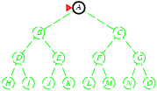
Week 2: Depth-first search
Expand deepest unexpanded node
Frontier = Last In First Out (LIFO) queue, i.e., new successors go at the front of the queue.
Goal-Test when inserted.
Future= green dotted circles
Frontier=white nodes
Expanded/active=gray nodes
Forgotten/reclaimed= black nodes
Initial state = A
Is A a goal state?
Put A at front of queue.
frontier = [A]

Slide 23
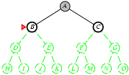
Week 2: Depth-first search
Expand deepest unexpanded node
Frontier = LIFO queue, i.e., put successors at front
Expand A to B, C.
Is B or C a goal state?
Put B, C at front of queue.
frontier = [B,C]
Future= green dotted circles
Frontier=white nodes
Expanded/active=gray nodes
Forgotten/reclaimed= black nodes

Slide 24
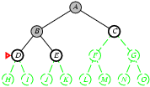
Week 2: Depth-first search
Expand deepest unexpanded node
Frontier = LIFO queue, i.e., put successors at front
Expand B to D, E.
Is D or E a goal state?
Put D, E at front of queue.
frontier = [D,E,C]
Future= green dotted circles
Frontier=white nodes
Expanded/active=gray nodes
Forgotten/reclaimed= black nodes

Slide 25
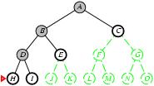
Week 2: Depth-first search
Expand deepest unexpanded node
Frontier = LIFO queue, i.e., put successors at front
Expand D to H, I.
Is H or I a goal state?
Put H, I at front of queue.
frontier = [H,I,E,C]
Future= green dotted circles
Frontier=white nodes
Expanded/active=gray nodes
Forgotten/reclaimed= black nodes

Slide 26
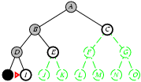
Week 2: Depth-first search
Expand deepest unexpanded node
Frontier = LIFO queue, i.e., put successors at front
Future= green dotted circles
Frontier=white nodes
Expanded/active=gray nodes
Forgotten/reclaimed= black nodes
Expand H to no children.
Forget H.
frontier = [I,E,C]

Slide 27
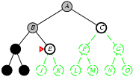
Week 2: Depth-first search
Expand deepest unexpanded node
Frontier = LIFO queue, i.e., put successors at front
Expand I to no children.
Forget D, I.
frontier = [E,C]
Future= green dotted circles
Frontier=white nodes
Expanded/active=gray nodes
Forgotten/reclaimed= black nodes

Slide 28
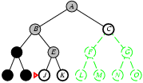
Week 2: Depth-first search
Expand deepest unexpanded node
Frontier = LIFO queue, i.e., put successors at front
Expand E to J, K.
Is J or K a goal state?
Put J, K at front of queue.
frontier = [J,K,C]
Future= green dotted circles
Frontier=white nodes
Expanded/active=gray nodes
Forgotten/reclaimed= black nodes

Slide 29
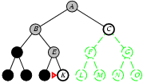
Week 2: Depth-first search
Expand deepest unexpanded node
Frontier = LIFO queue, i.e., put successors at front
Expand I to no children.
Forget D, I.
frontier = [E,C]
Future= green dotted circles
Frontier=white nodes
Expanded/active=gray nodes
Forgotten/reclaimed= black nodes

Slide 30
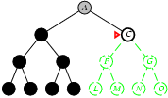
Week 2: Depth-first search
Expand deepest unexpanded node
Frontier = LIFO queue, i.e., put successors at front
Expand K to no children.
Forget B, E, K.
frontier = [C]
Future= green dotted circles
Frontier=white nodes
Expanded/active=gray nodes
Forgotten/reclaimed= black nodes

Slide 31
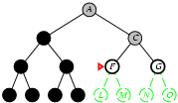
Week 2: Depth-first search
Expand deepest unexpanded node
Frontier = LIFO queue, i.e., put successors at front
Future= green dotted circles
Frontier=white nodes
Expanded/active=gray nodes
Forgotten/reclaimed= black nodes
Expand C to F, G.
Is F or G a goal state?
Put F, G at front of queue.
frontier = [F,G]

Slide 32
Week 2: Depth-first search
Properties of DFS
Not Complete
Not guaranteed to a finds a solution if one exists
Not Optimal
May not terminate without a depth bond (i.e. cutting off the search below a fixed depth)
Exponential time complexity
O(b^{d}) nodes will be generated, where d is the depth of the solution and b is the branching factor (number of children at each node)
Linear Space Complexity
O(bd) nodes will be stored in the memory

Slide 33
Examples
Uninformed Search Examples

Slide 34
Week 2: Uninformed Search Examples
Show how the following search algorithms will search the following search tree, show the solution path in each case and the cost of each solution:
(a) BFS
(b) DFS
S
1
5
8
A
B
C
3
7 9 4
5
D
E
G

Slide 35
Week 2: Informed Search Algorithms
Unlike the uninformed search, the informed search algorithm:
Have all the necessary information needed to make a decision on which path to take
Uses additional knowledge about the problem domain to select the best path
Heuristics are used, which are informed guesses
A heuristics is a function that estimate the cost of reaching a goal from a given state (node)

Slide 36
Week 2: Best First Search Algorithm
Best First Search
General form of Informed Search Algorithms
Node is selected for expansion based on evaluation function f(n)
Sort nodes in the OPEN list by increasing values of an evaluation function f(n), that incorporates domain-specific information
Expand the lowest cost node first

Slide 37
Week 2: Best First Search Algorithm
Often for best search algorithm, f(n) is defined in terms of a heuristic function h(n)
h(n) = estimated cost of the cheapest path from the state at node n to a goal state (for goal state h(n) = 0)
Heuristics are the common way in which additional knowledge is passed to the search algorithm
Define a heuristic function, h(n)
If h(n1) < h(n2), we guess it is cheaper to reach the goal from n1, than n2.
We require h(n) = 0, for a goal state

Slide 38
Week 2: Greedy Best-First Search
Greedy Best-First Search
Use an evaluation function, f(n) = h(n), to rank nodes in the OPEN by increasing values of f
Selects the node to expand that is believed to be closest (i.e., smallest f value) to a goal node
Greedy best first search greedily tries to achieve a low cost solution
Greedy best search ignores the cost of getting to n, so it may lead astray exploring nodes that cost a lot but seem to be close to the goal.

Slide 39
Week 2: Greedy Best-First Search
Properties of GBFS
Complete: NO
Optimal: NO
Time and space complexity: O(b^{d}) (i.e., exponential)

Slide 40
Week 2: A* Search Algorithm
A* Search Algorithm
Best form of Best Search Algorithm
Takes into account the cost of getting to a node as well as the estimated cost of getting to the goal from a given node
Define an evaluation function f(n)
f(n) = g(n) + h(n)
g(n) = actual cost to get to node n from start
h(n) = estimated cost to get to a goal from node n
Always expand the node with the lowest f-value on OPEN
The f-value, f(n) is an estimation of the cost of getting to the goal via the node (path) n.

Slide 41
Week 2: A* Search Algorithm
Properties of A* Search
Complete: Yes
Optimal: Yes
Time and space complexity: O(b^{d}) (i.e., exponential)

Slide 42
Week 2: A* Search Algorithm
Admissible heuristics
A heuristics h(n) is admissible if for every node n,
h(n) <= h*(n)
where h*(n) is the true cost to reach the goal state from node n.
An admissible heuristics never overestimate the cost to reach the goal

Slide 43
Informed Search Examples

Slide 44
Week2: Review Questions
Explain the differences and similarities between depth-first search and breadth-first search. Give examples of the kinds of problems where each would be appropriate.
Explain what is meant by the following terms in relation to search methods:
Complexity
Completeness
Optimality
What is the complexity (in space and in time) of the following search methods:
depth-first search
breadth-first search
best-first search
greedy search

